Slide 1



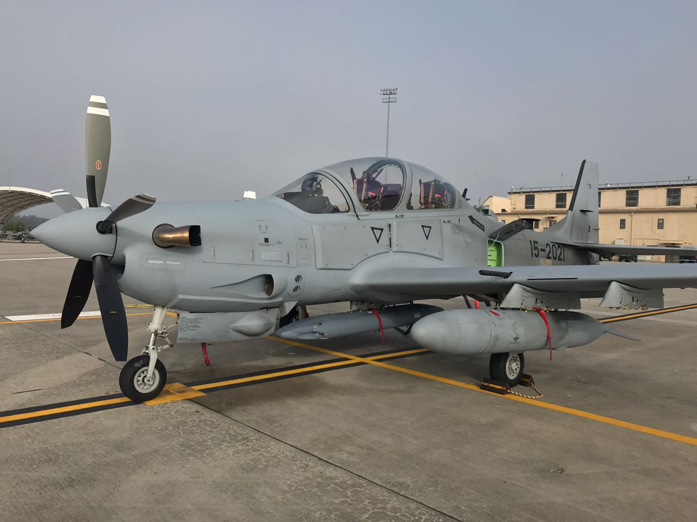
LEBANESE
AIR FORCE
A-29B
Supertucano

Slide 2
Overview
Procurement
Specifications
Operational Capabilities
Munitions
Challenges
Summary

Slide 3
Procurement

Slide 4
Procurement
CASE | Type | Content |  | $ Total Estimated Cost
LE-D-SAH | Air Crafts procurement | 6 A/C A-29 1 spare engine Cartridges Radios GPS Turrets A/C components Support Equipment | Alternate Mission Equipment publications Pilots Flying gears PMEL Service Support Modifications Ferry Training | 204,479,297
LE-B-WBX | Munitions | 0.50 cal. 2.75 inch rockets |  | 3,099,154
LE-D-AAB | Munitions | BOMB GP BLU-III B/B 500 LB 2.75 inch rockets Flares Bombs for Practice Cartridges Munitions Training |  | 10,609,630
LE-D-QAD | Sustainment | Spares Support Equipment R&R FSR Training Software Cartridges |  | 9,536,940
LE-P-AAB | Munitions | APKWS Training |  | 7,147,623
LE-D-TFT | Training | Flight Training |  | 5,000,000
LE-D-TNF | Training | Maintenance Training |  | 750,000
$Total |  |  |  | 240,622,644

Slide 5
Program Management Reviews
# | Location | Date
PMR#1 | Nicosia | 11-15 April 2016
PMR#2 | Jacksonville FL. | 07-10 November 2016
PMR#3 | Savannah GA. | 22-26 May 2017
PMR#4 | Valdosta GA. | 30-31 August 2017

Slide 6
Procurement
Specifications

Slide 7
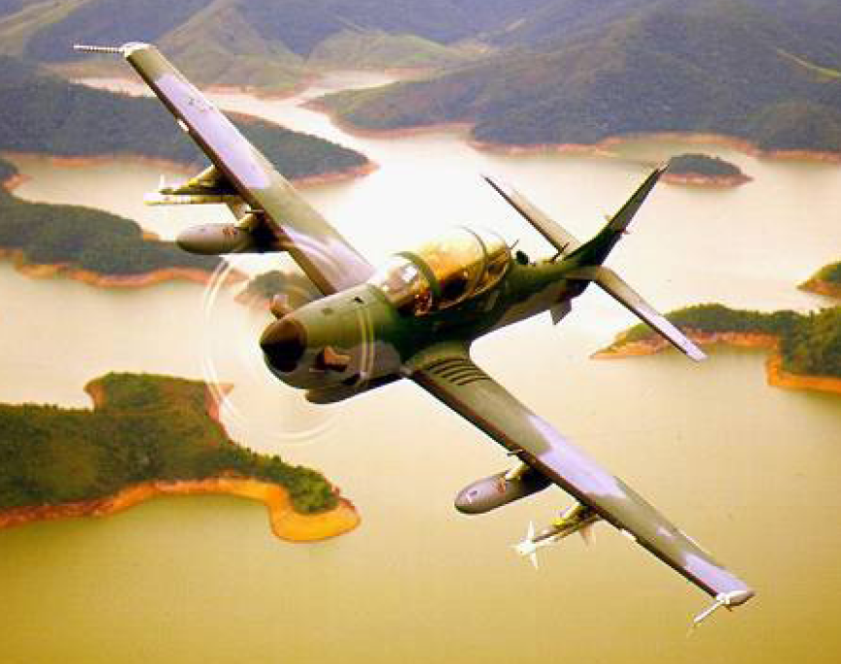
AIRCRAFT OVERVIEW
GENERAL CONFIGURATION:
Low-wing
Single-Turboprop engine
Pressurized cabin up to 5 psid.
Two pilots in tandem-seats configuration
.

Slide 8
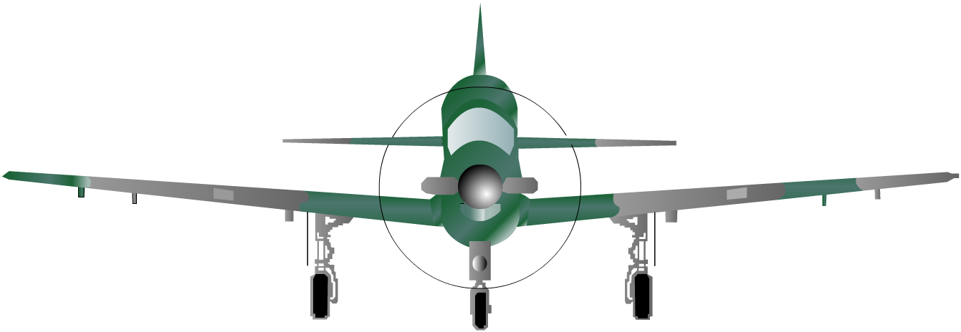
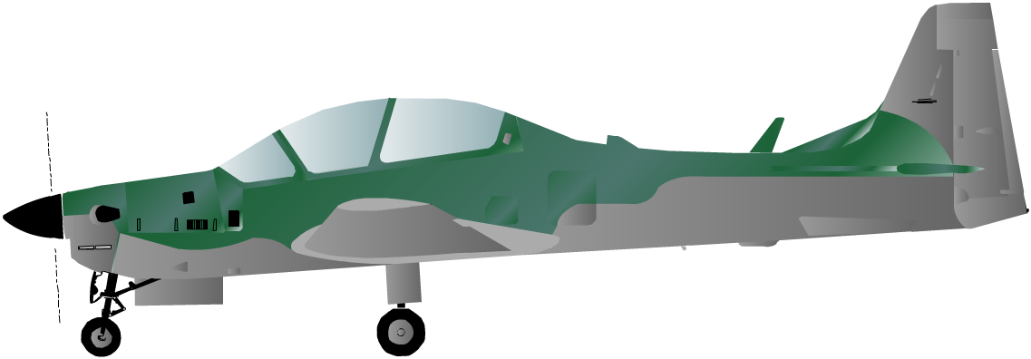
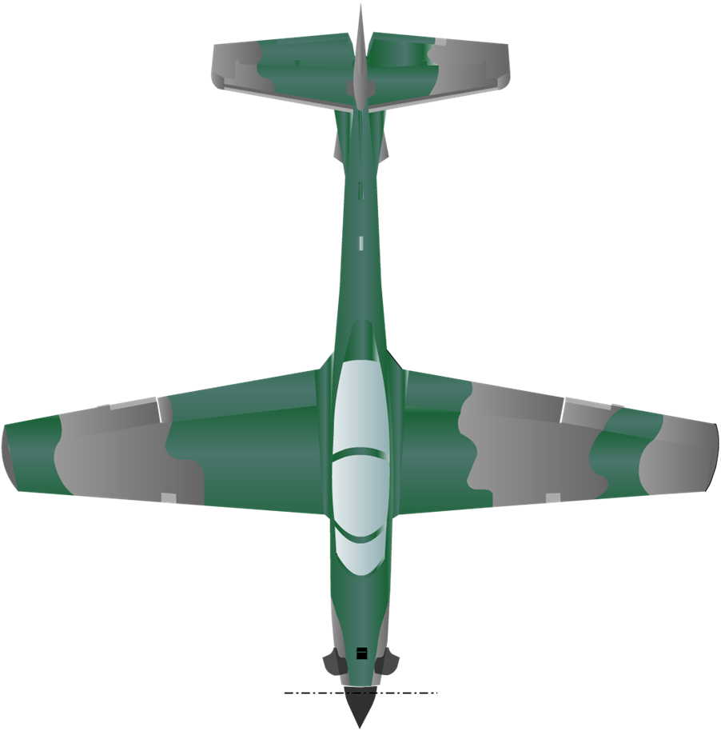
EXTERNAL DIMENSIONS
3,97 m 13.0’
3,77 m 12’4”
11,14 m 36’6”
3,36 m 11.0’
11,38 m 37’4”
4,68 m 15’4”

Slide 9
EXTERNAL DIMENSIONS
3,77 m 12’4”
11,14 m 36’6”

Slide 10
EXTERNAL DIMENSIONS
3,97 m 13.0’
3,36 m 11.0’
11,38 m 37’4”

Slide 11
EXTERNAL DIMENSIONS
4,68 m 15’4”

Slide 12
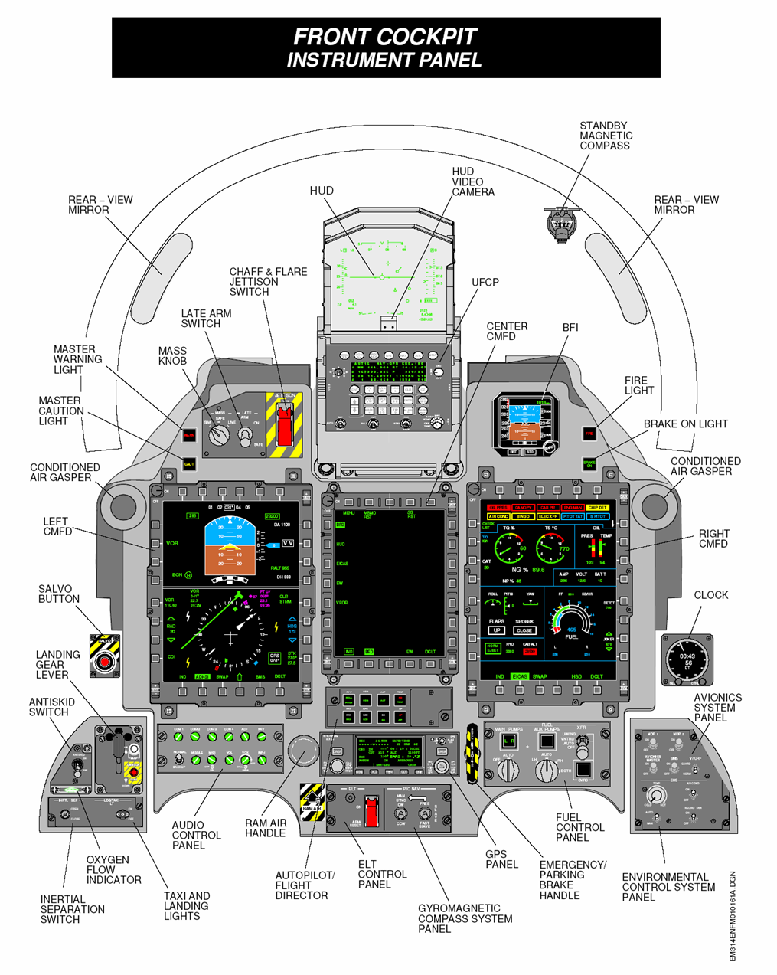
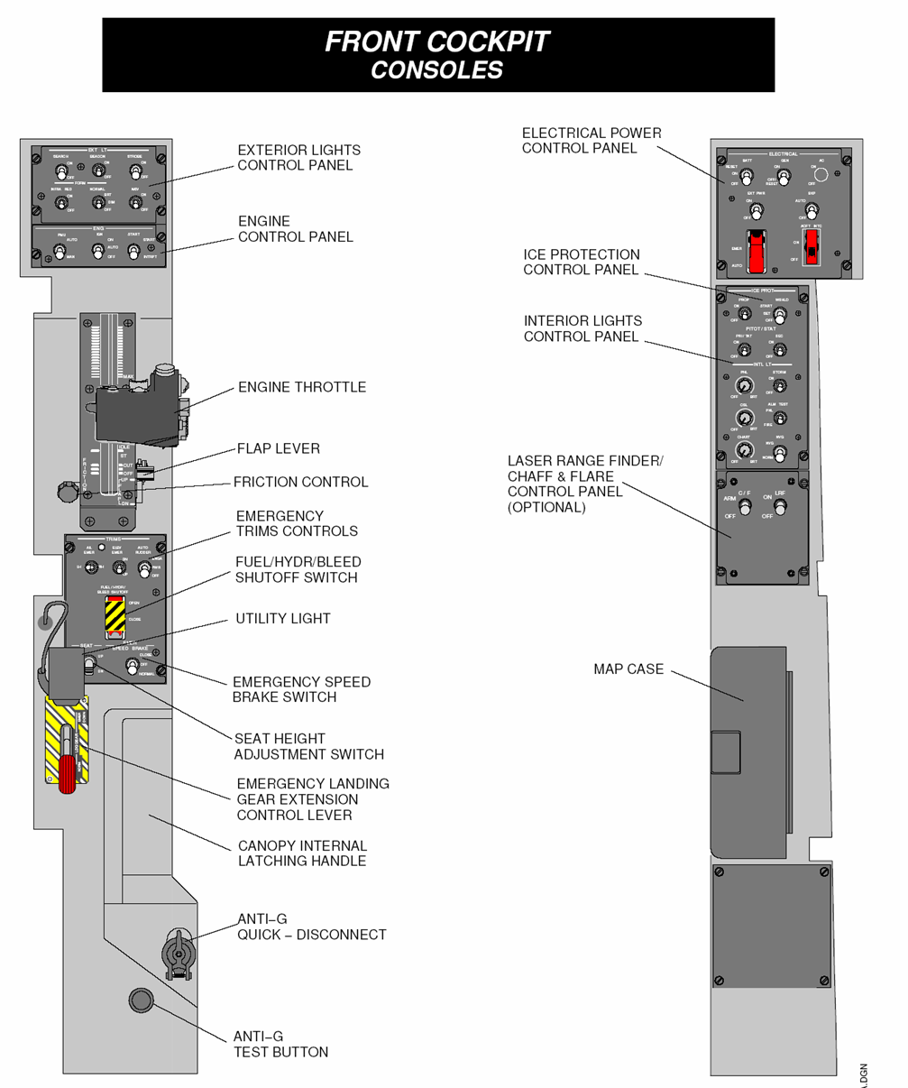

Slide 13
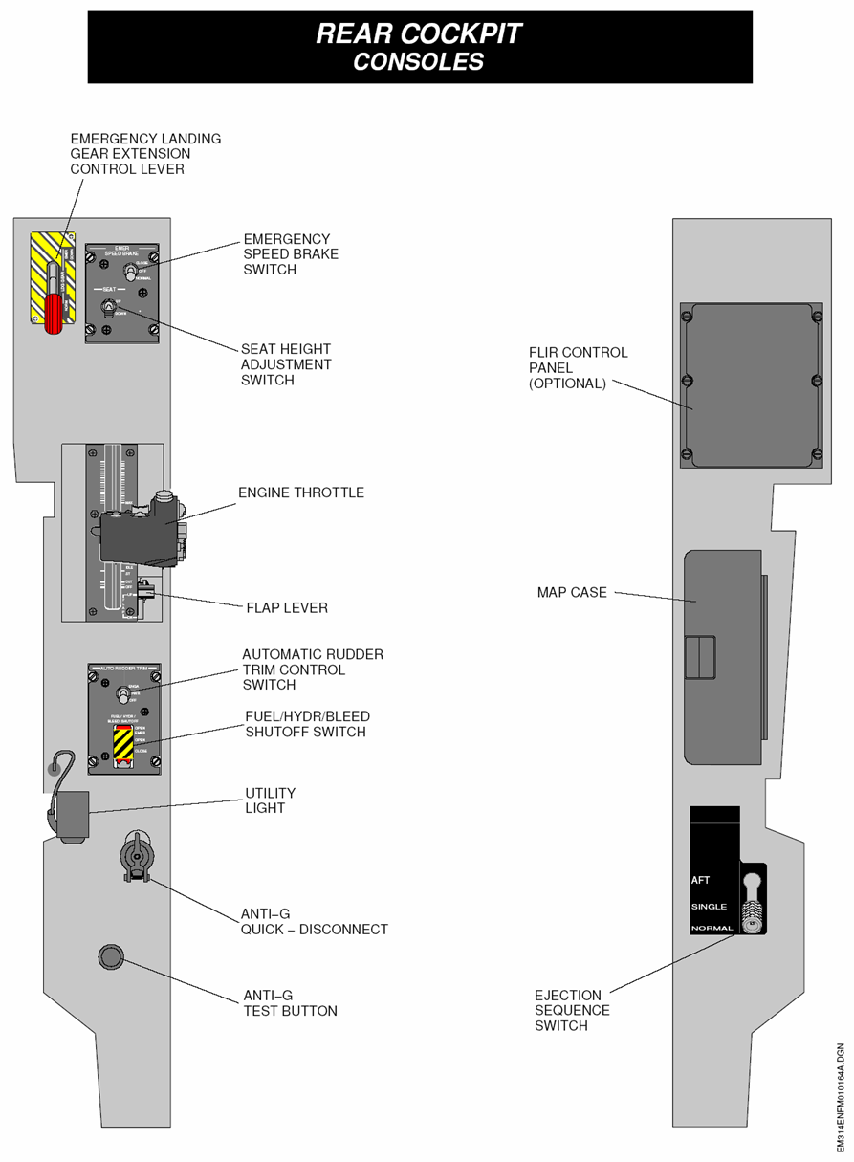
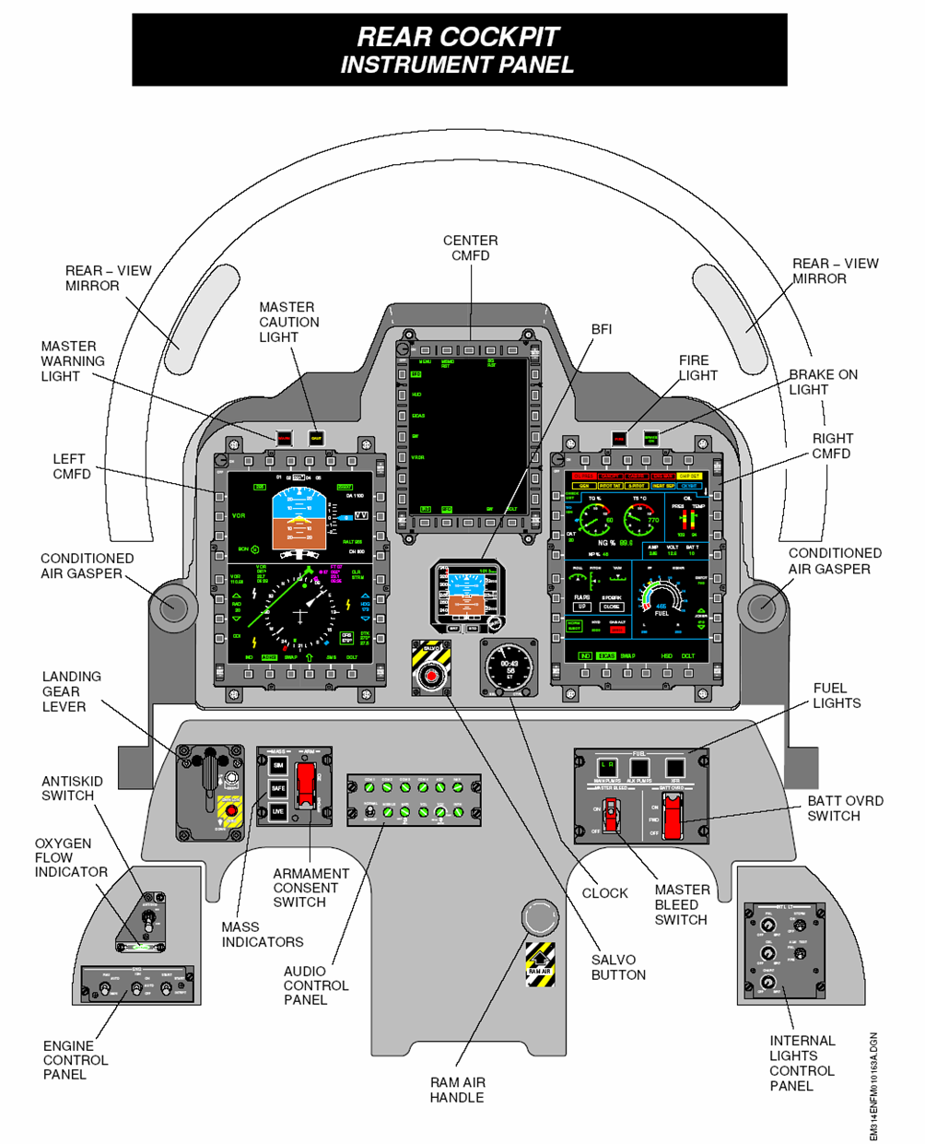
Notes:
Color multifunctional flight display

Slide 14
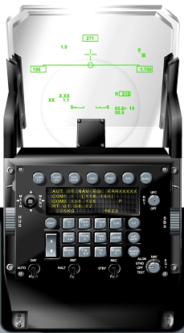

Notes:
Navigational or air to ground; ccip (diving) ccrp (streight) dtos

Slide 15
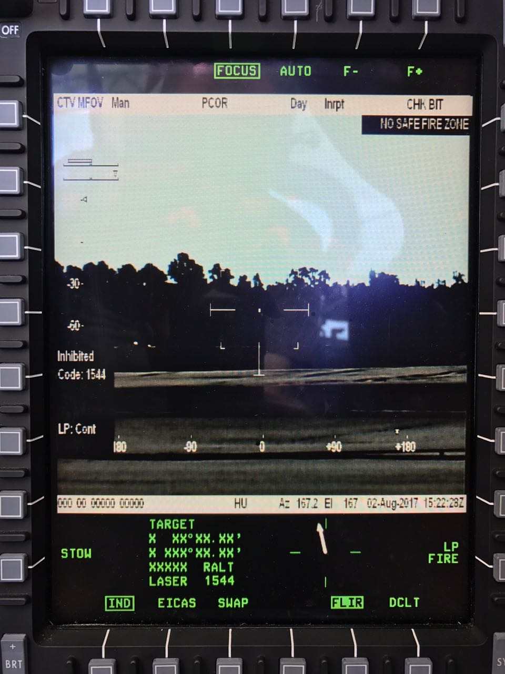
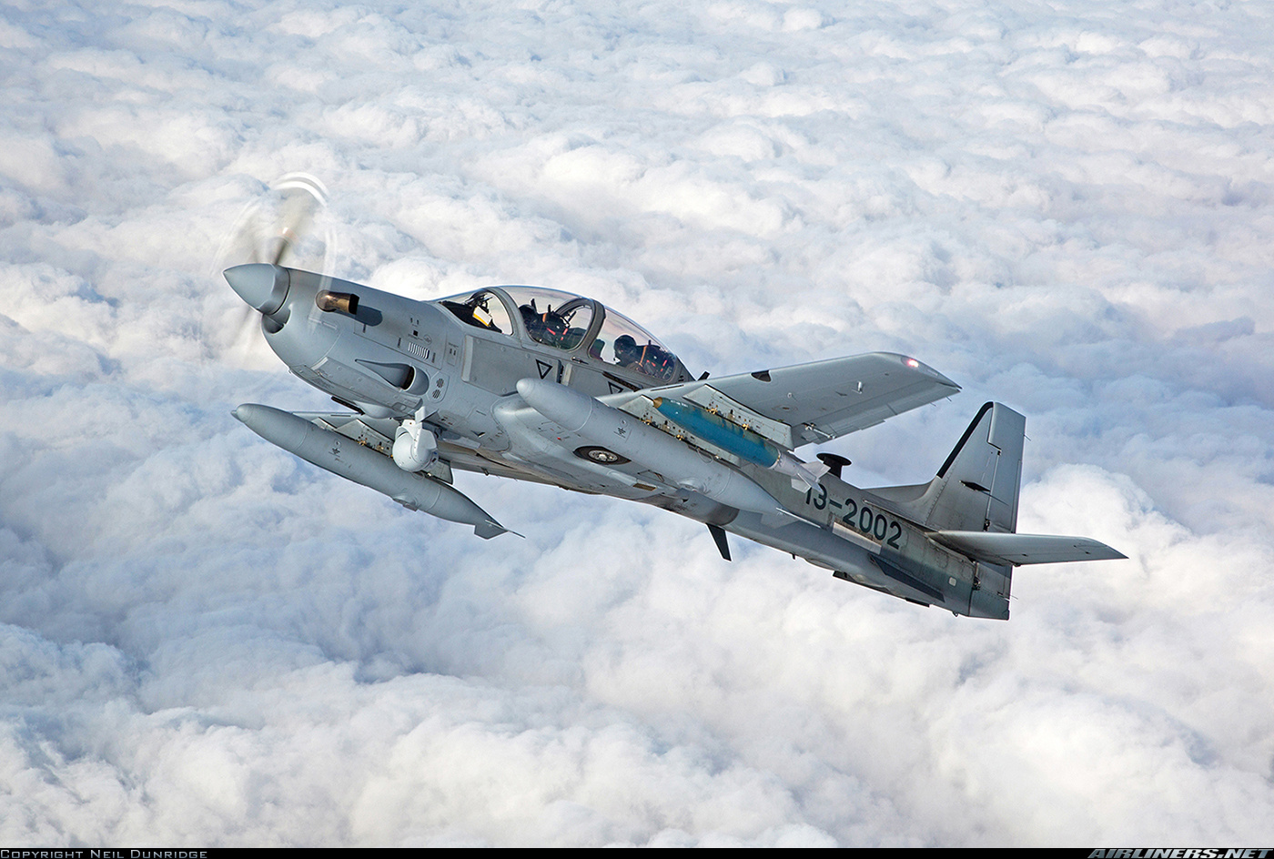
FLIR BRITE STAR DP

Slide 16
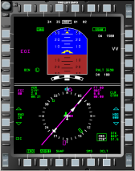
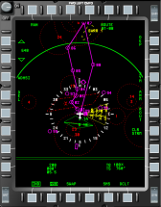
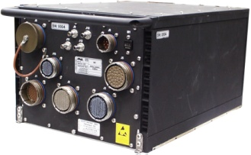
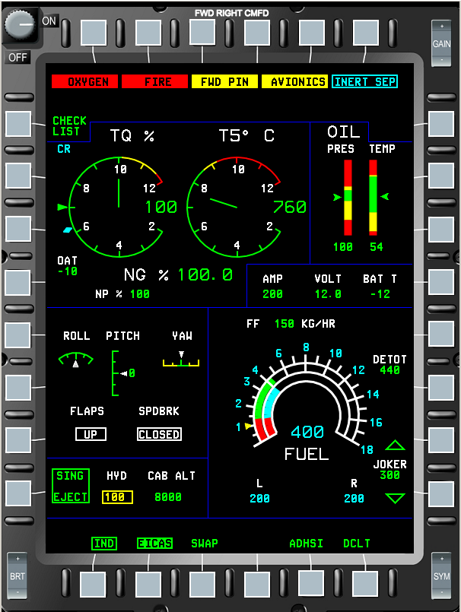
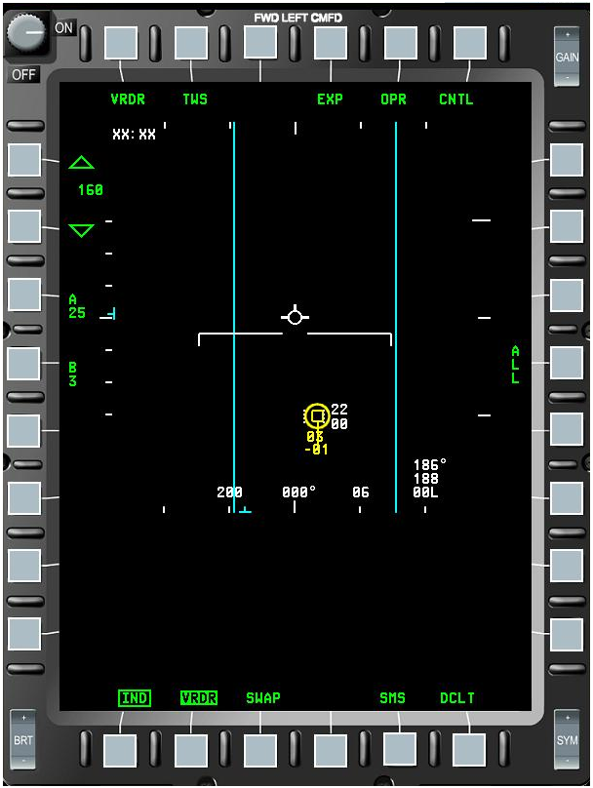

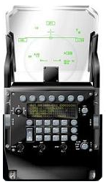
AVIONICS SYSTEM
CMFD 1
HUD UFCP
CMFD 5
CMFD 2
CMFD 3
CMFD 6
CMFD 4
VIDEO
RS422
VIDEO
RS422
MDP1
MDP2
Notes:
Mission and display Processor

Slide 17
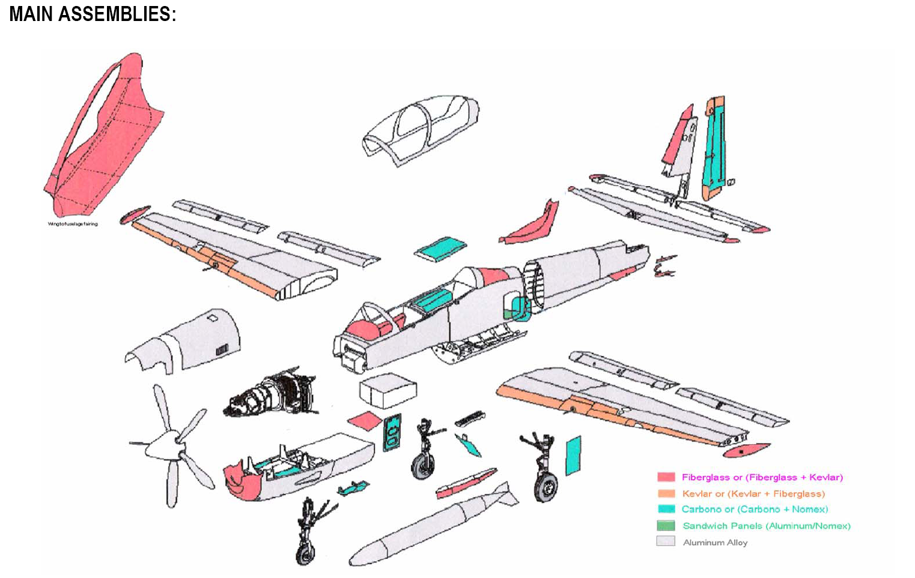
Structure

Slide 18
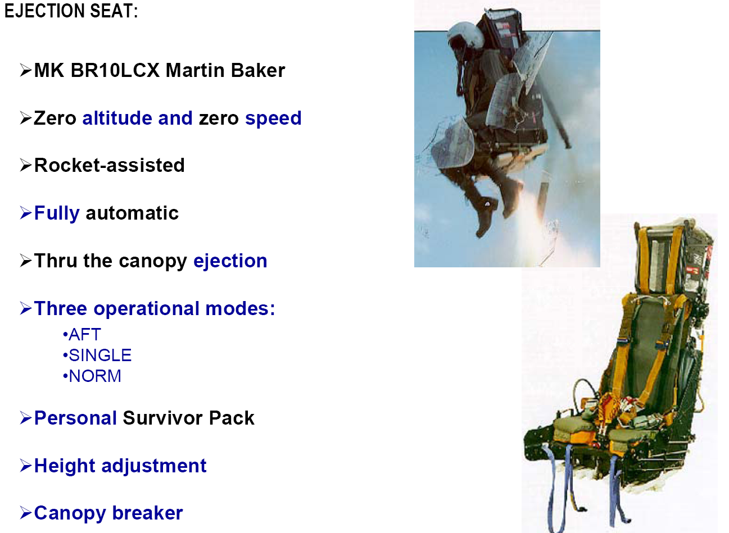

Slide 19
Procurement
Specifications
Operational Capabilities

Slide 20
Operational Capabilities
MAXIMUM OPERATIONAL ALTITUDE:35000 Ft
VMO: 320 Kts(MAXIMUM OPERATING SPEED)
Endurance:90 minutes (according to configuration and external fuel)
Payload 1500 KG
Runway Needed: between 2000 and 3600 feet according to weight and external conditions

Slide 21
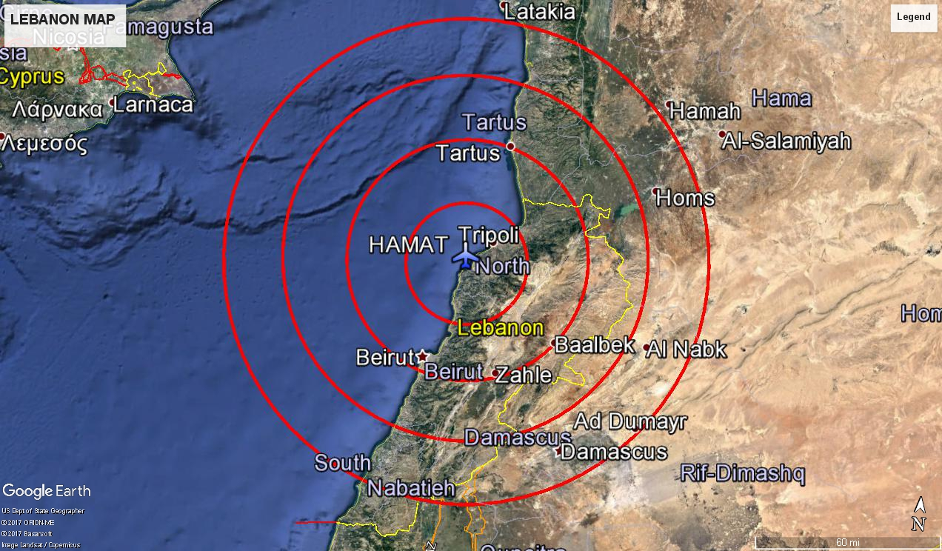
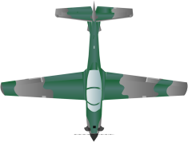
5 min
10 min
15 min
20 min
25 minutes to the furthest point from HAMAT with 35 minutes playtime over TGT

Slide 22
Procurement
Specifications
Operational Capabilities
Munitions

Slide 23
Munitions
M3M Machine Gun
LM 70/7-SF-M9 MK2 Multiple Launcher (Hydra (M66) rocket and APKWS)
MK81 and MK 82 Bombs
GBU-12 and GBU-58 Laser Guided Bombs

Slide 24
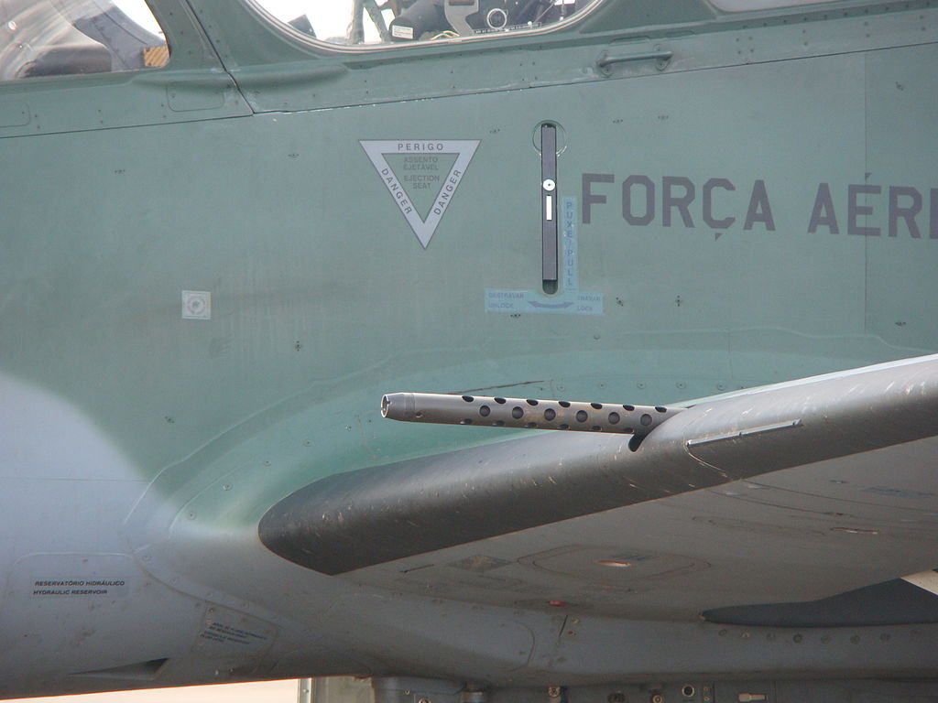
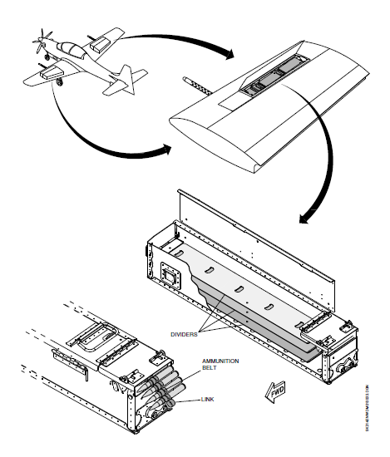
M3M machine gun
Wing Mounted
Caliber 12.7 mm
Rate of fire 1100 rounds per minute
Capacity: 2 * 250 rounds
Max Effective Range: 1850 m
Sighting is provided by HUD
MDP (Mission and Display Processor) provides all ballistic calculations for accurate hits

Slide 25
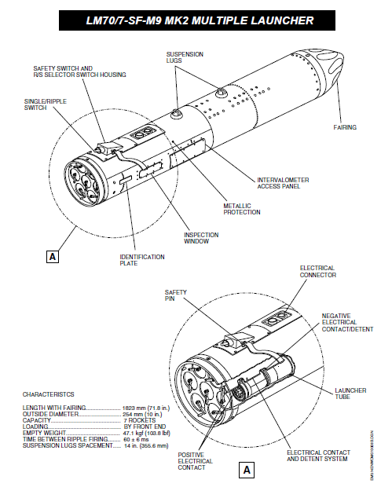
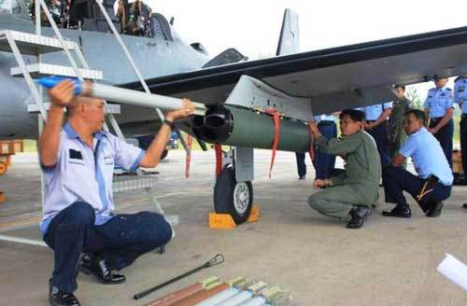
LM 70/7-SF-M9 MK2 Multiple Launcher

Slide 26
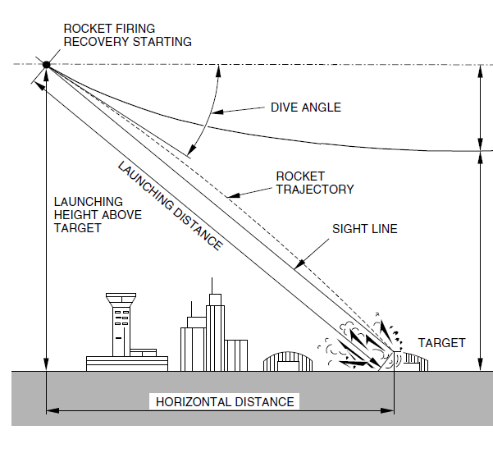
LM 70/7-SF-M9 MK2 Multiple Launcher
Caliber 70mm
Capacity 7 rockets
Munitions type: M66 (Unguided) and APKWS (Laser Guided)
Sighting provided by HUD
WDNS weapon Delivery and Navigation system performs ballistic calculations and corrects for wind

Slide 27
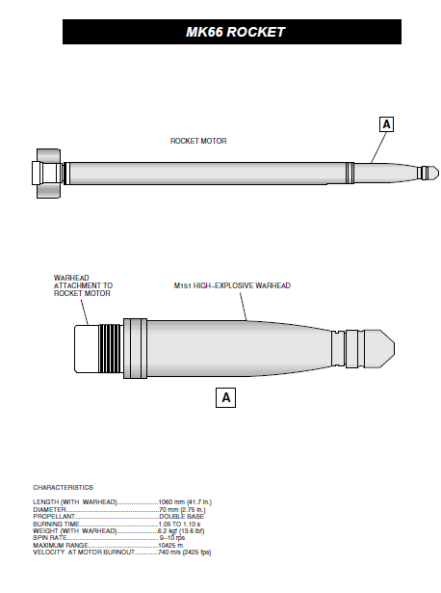

Slide 28
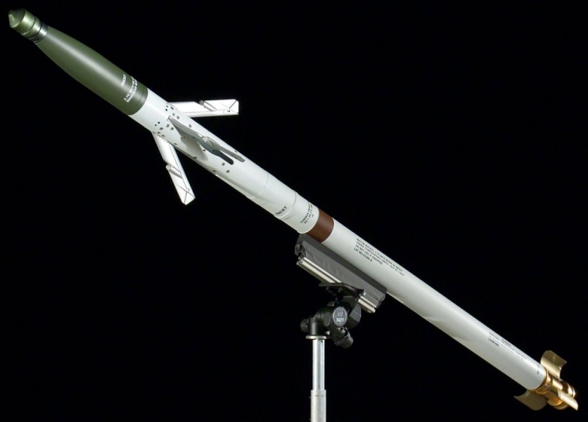
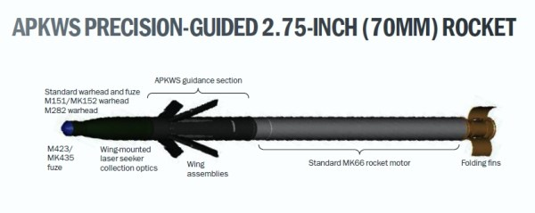
APKWS (advanced precision kill weapon system)
Laser Guided
Launched the same way as the M66 rocket
Same warhead and rocket motor as M66
Airborne or Ground designation

Slide 29
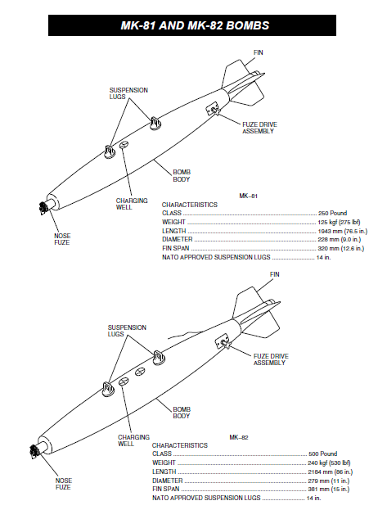
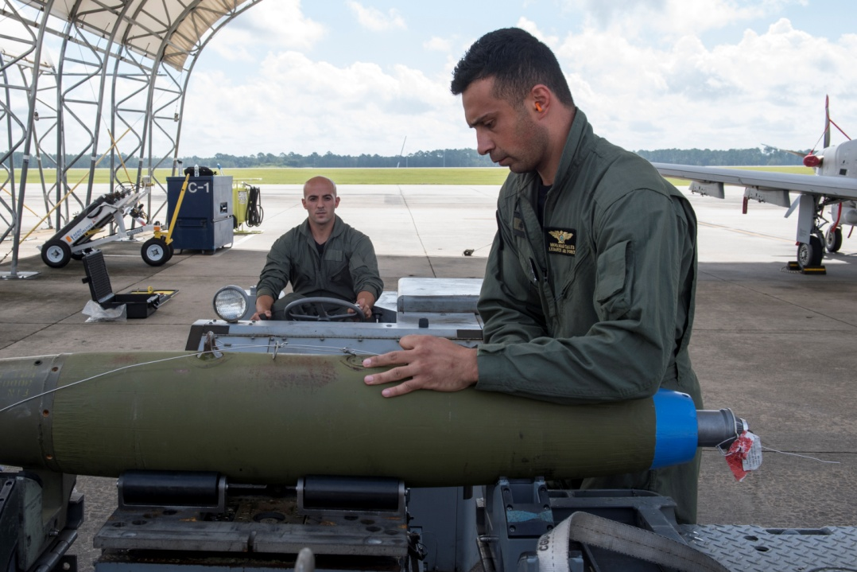
Unguided Bombs
Computerized Sighting System through HUD
Corrects for wind
Bombs can be released as single, pair, or Ripple (In sequence)

Slide 30
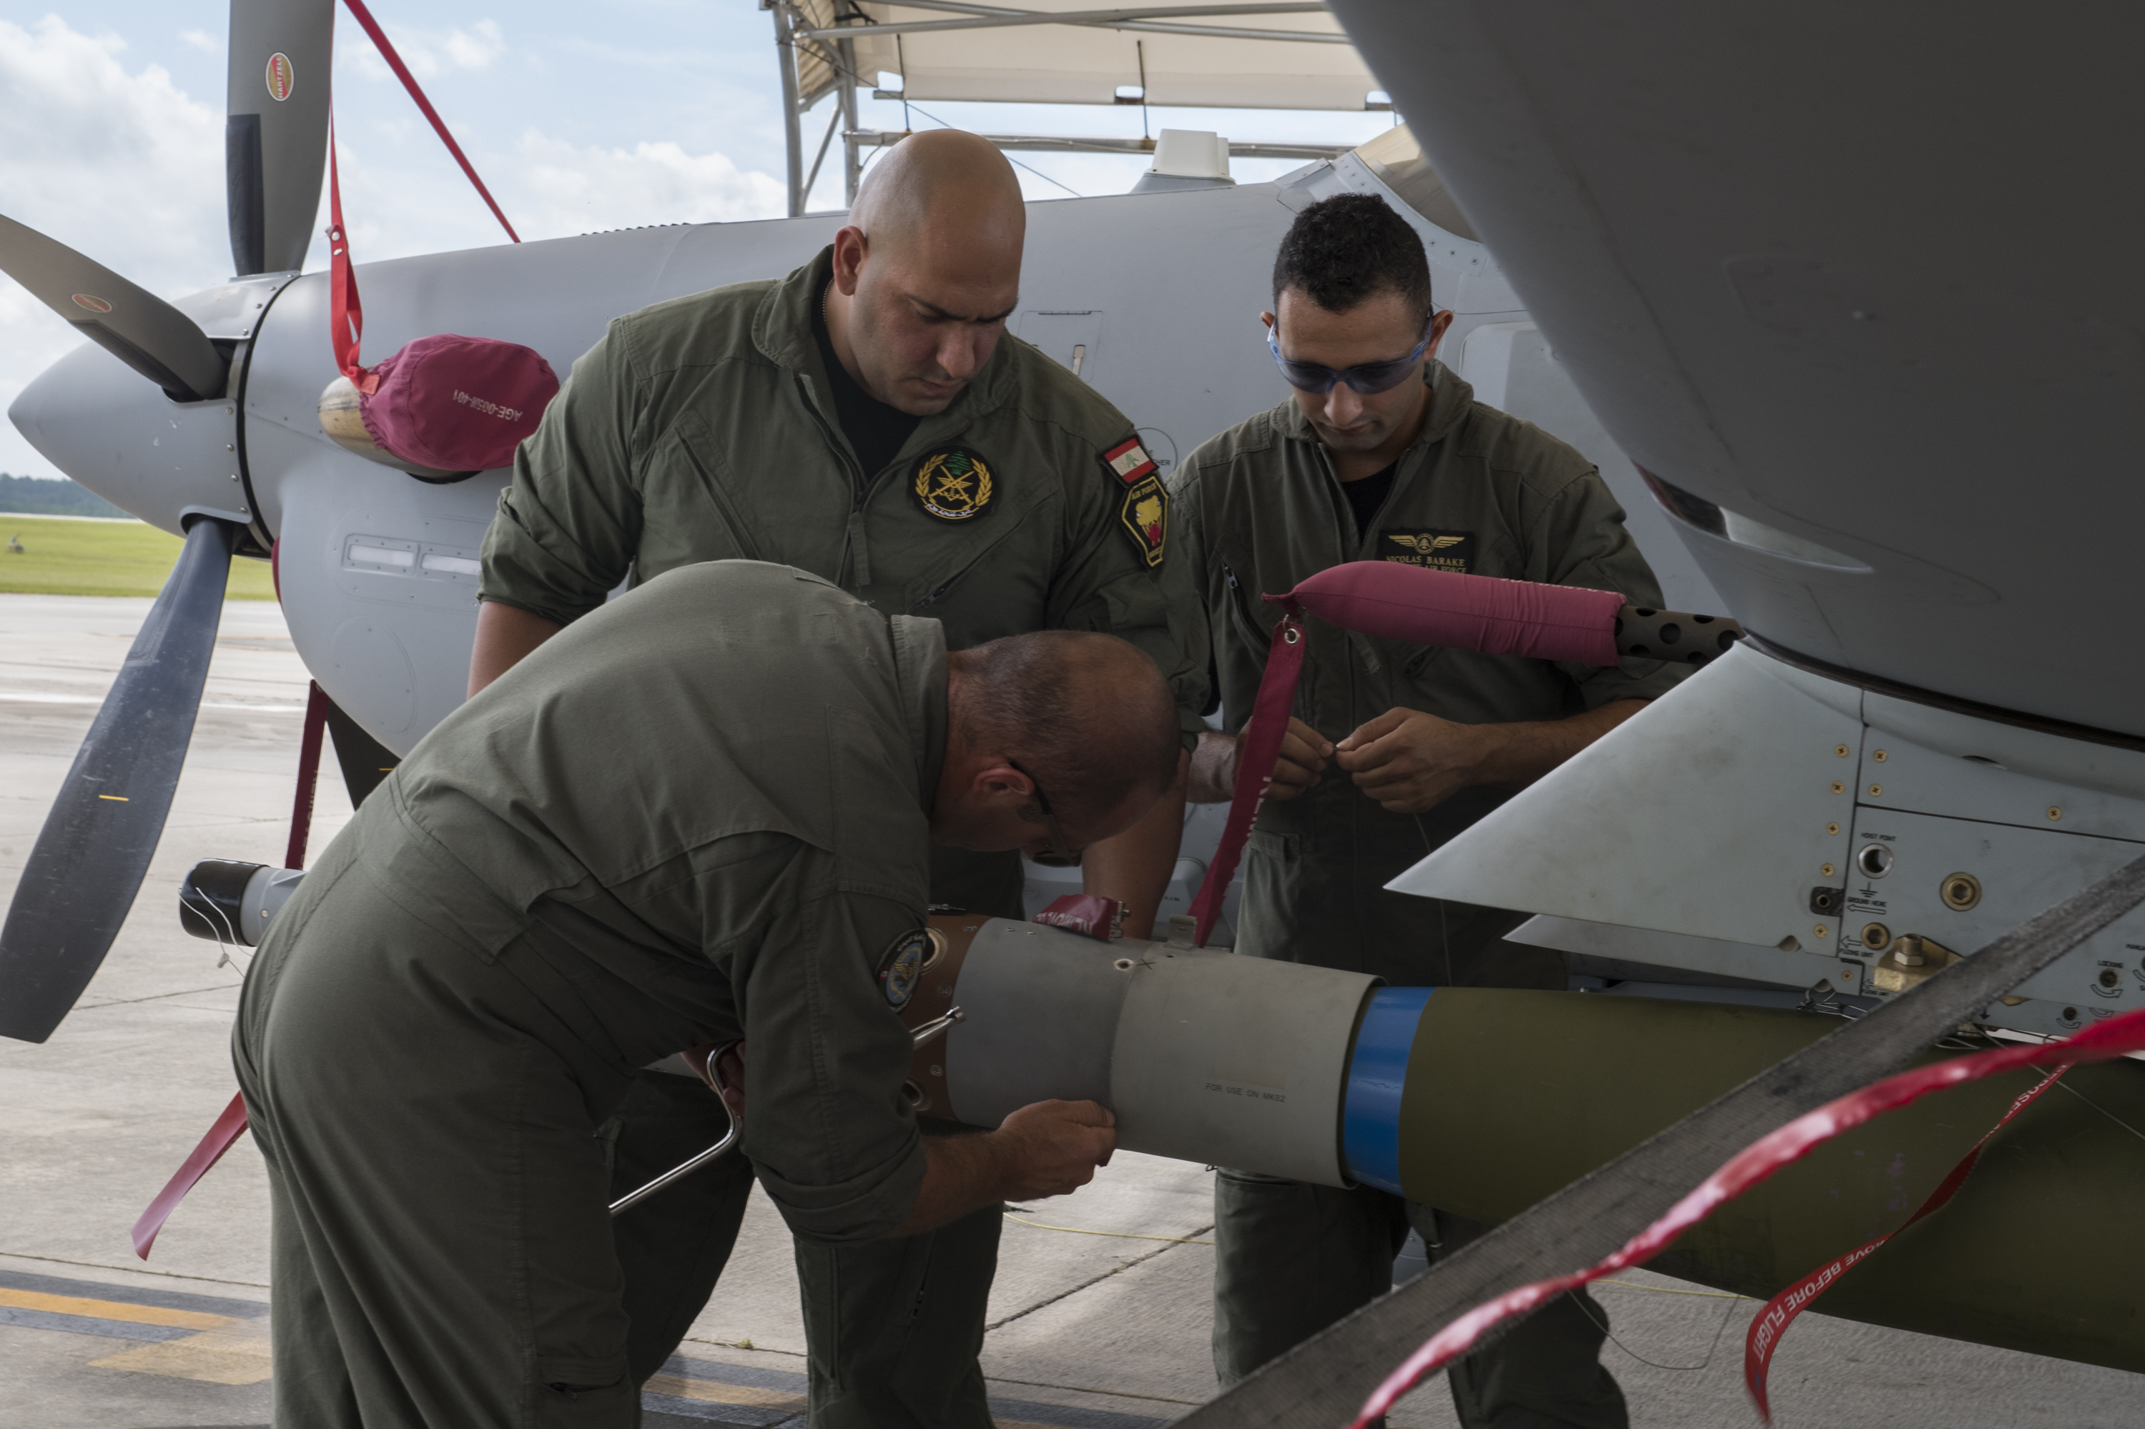
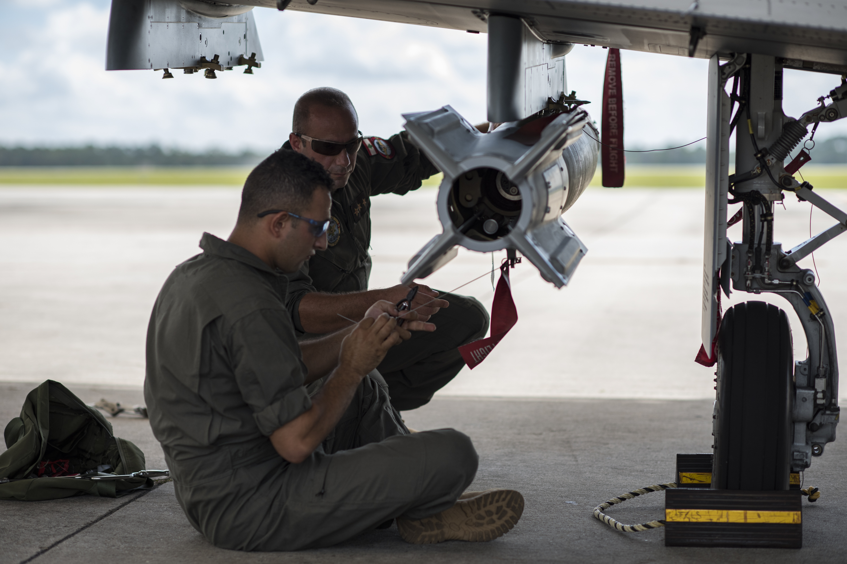
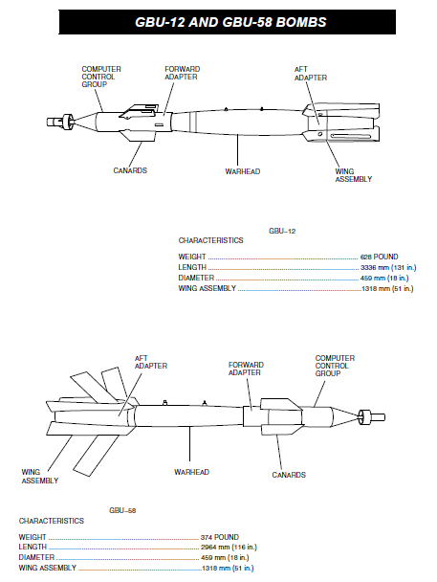
GBU-12 and GBU-58 Laser Guided Bombs
The Computer control Group and the Airfoil Group control the bombs travel to target
Airborne or Ground designation
Controls are activated after Launch

Slide 31
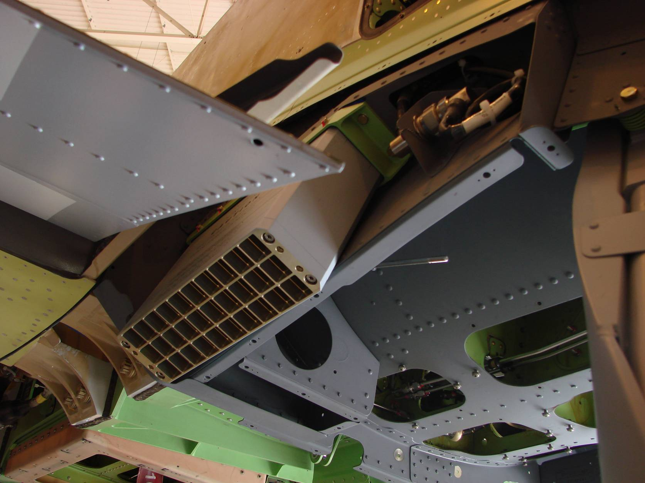
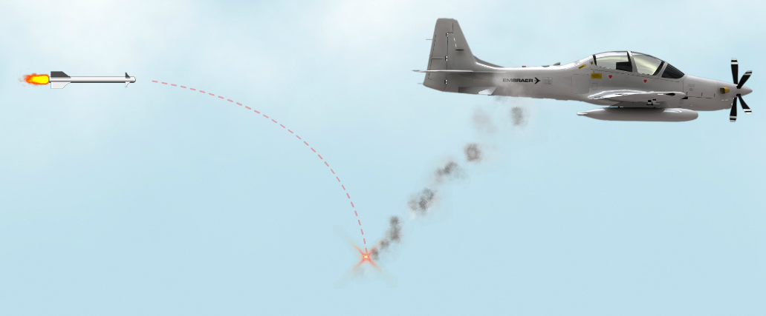
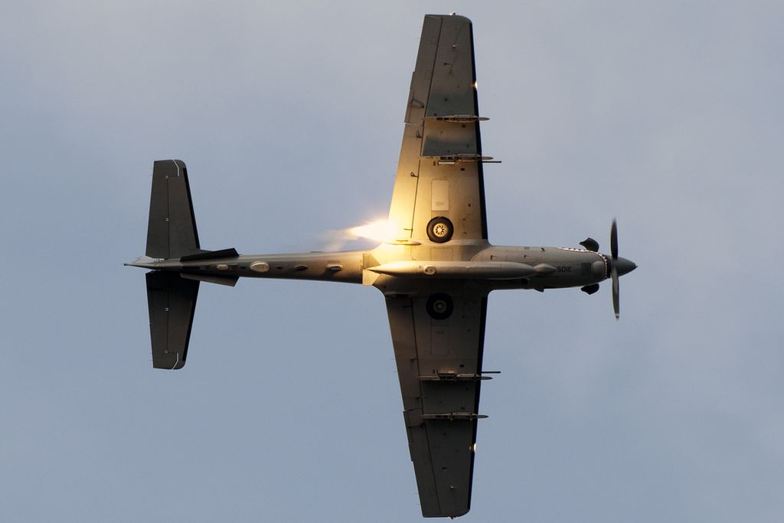
Flare Dispenser
Manual Countermeasure
No IR sensors
Ability to dispense all flares at one time

Slide 32
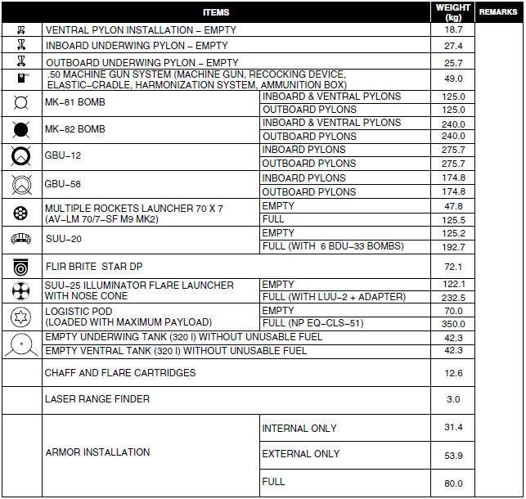
Configuration
Weapons Configuration is chosen according to mission requirements
5 hard points able to carry multiple weapon types and external fuel tanks

Slide 33
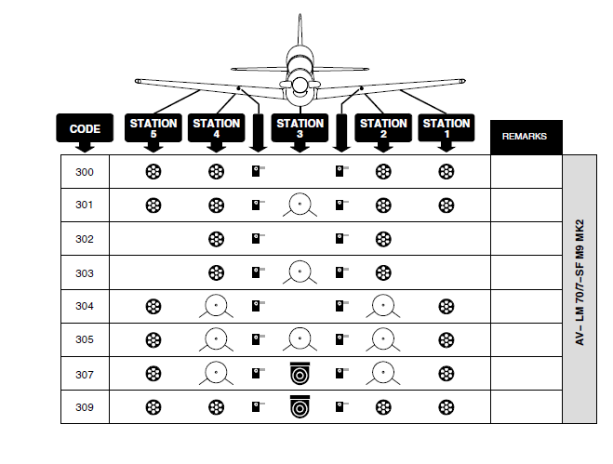
Example
Ability to Launch 4*7 rockets
and to laser designate
4 rocket Launchers
FLIR

Slide 34
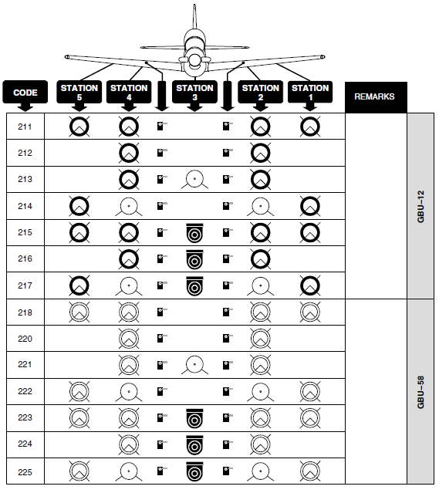
Example
Ability to lase and drop GBU-12
But with limited endurance
Increased endurance but less munitions

Slide 35
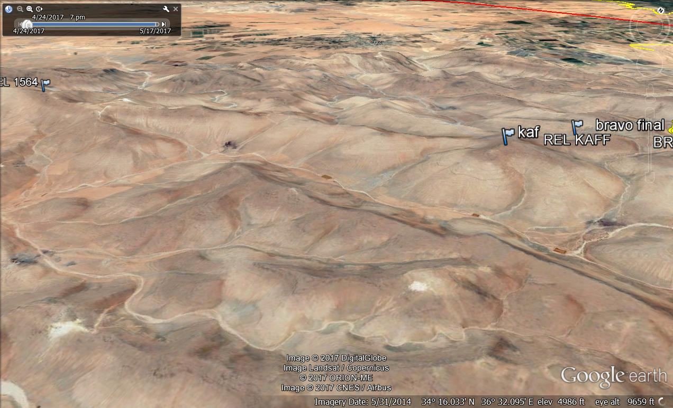
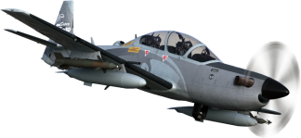
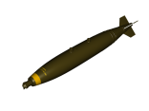
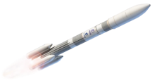

Pilot can laze for himself and for his wingman

Slide 36
Procurement
Specifications
Operational Capabilities
Munitions
Challenges

Slide 37
Challenges
Night and IFR Incapability at Home Base

Slide 38
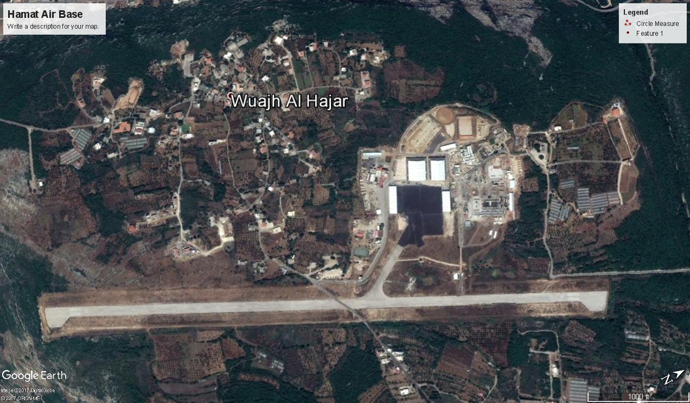
No Navaids or Airfield Lighting in home base
Notes:
Parallel taxiway
Runway lights
NAVaid for the airfield to be fully operational day and night with no restrictions

Slide 39
Challenges
Night and IFR Incapability at Home Base
Urgent Need to establish a parallel Taxiway

Slide 40
URGENT NEED TO ESTABLISH A PARALLEL TAXIWAY
Consequences:
Mission Planning is performed with additional reserve fuel in case of a mishap on the main runway
Reduced endurance and playtime over target
Notes:
Parallel taxiway
Runway lights
NAVaid for the airfield to be fully operational day and night with no restrictions

Slide 41
Challenges
Night and IFR Incapability at Home Base
Urgent Need to establish a parallel Taxiway
Find an alternative to the road crossing the runway

Slide 42
Find an Alternative to The Runway- crossing Road
Road is very essential and connects both villages
Preplanned road around the runway
Consequences:
  A huge Safety Compromise
Notes:
Parallel taxiway
Runway lights
NAVaid for the airfield to be fully operational day and night with no restrictions

Slide 43
Challenges
Night and IFR Incapability at Home Base
Urgent Need to establish a parallel Taxiway
Find an alternative to the road crossing the runway
Procure APKWS that are tested in November and expected to arrive in May 2018
Double the LAF Air force Capability by Procuring 6 additional A29 Super Tucanos

Slide 44
Acknowledgements
General Joseph Aoun LAF Commander and Staff
General Harrigian AFCENT Commander
US Ambassador Ms Richards and her staff especially ODC
Everybody who is attending

Slide 45
THANK YOU
WELCOME to
The LAF Air Force

